Slide 1


Janani G

Slide 2

Outline
01
Executive Summary
04
Results
02
Introduction
05
Conclusion
03
Methodology
06
Appendix

Slide 3
Executive Summary
• The following methodologies were used to analyze data:
• Data Collection using web scraping and SpaceX API;
• Exploratory Data Analysis (EDA), including data wrangling, data visualization and interactive
visual analytics;
• Machine Learning Prediction.
Summary of all results
• It was possible to collected valuable data from public sources;
• EDA allowed to identify which features are the best to predict success of launchings;
• Machine Learning Prediction showed the best model to predict which characteristics are
important to drive this opportunity by the best way, using all collected data.
4

Slide 4







Introduction
SpaceX’s goal:
Sending spacecraft to the International Space Station.
Starlink, a satellite internet constellation providing satellite Internet access.
Sending manned missions to Space.
Object
Spaces X’s Falcon 9 launch
Goal
To determine the price of each launch.
Reason
If we can determine if the first stage will land, we can determine the cost of a launch
Method
By gathering information about Space X and creating dashboards:
To determine if SpaceX will reuse the first stage
Train a machine learning model and use public information to predict if SpaceX will reuse the first stage
5

Slide 5

Section 1
6

Slide 6
Methodology
Data collection methodology:
  Require the data from SpaceX API
  Collect data from a Wikipedia page
Perform data wrangling
  Perform EDA to find some patterns
  Determine what would be the label for training supervised model
Perform exploratory data analysis (EDA) using visualization and SQL
Perform interactive visual analytics using Folium and Plotly Dash
Perform predictive analysis using classification models
  Compare logistic regression model, support vector machine tree decision classifier, KNN by using
GridSearchCV to select the best fit model
7

Slide 7
Data Collection
1
API
2
Web page
spacex_url="https://api.spacexdata.com/v4/ launches/past"
https://en.wikipedia.org/wiki/List_of_Falcon\_9
\_and_Falcon_Heavy_launches
Required the data from Space API
Clean the data
Extract a Falcon 9 launch records HTML table from Wikipedia
Parse the table and convert it into a Pandas data frame

Slide 8

Data Collection – SpaceX API
Request data from SpaceX API
Convert the json result into a dataframe
Filter dataframe to only Falcon 9` launches and data wrangling
Export to csv
Link :
https://github.com/Jananijana2712/SpaceX-Falcon_9_First_Stage_Landing_Prediction/blob/main/1.1%20SpaceX%20the%20Data%20Collection%20API%20Lab.ipynb
A
Request data
B
Convert into dataframe
C
Data wrangling
D
Save to csv file

Slide 9
A
Data Collection – Scraping
Request the Falcon9 Launch Wiki page from its URL
Extract all column/variable names from the HTML table header
Create a data frame by parsing the launch HTML tables
Export to csv
Link :
https://github.com/Jananijana2712/SpaceX-Falcon_9_First_Stage_Landing_Prediction/blob/main/1.2%20SpaceX%20the%20Data%20Collection%20with%20Web%20Scraping%20lab.ipynb
Request data
B
Extract data
C
Parse data
D
Save to csv file

Slide 10
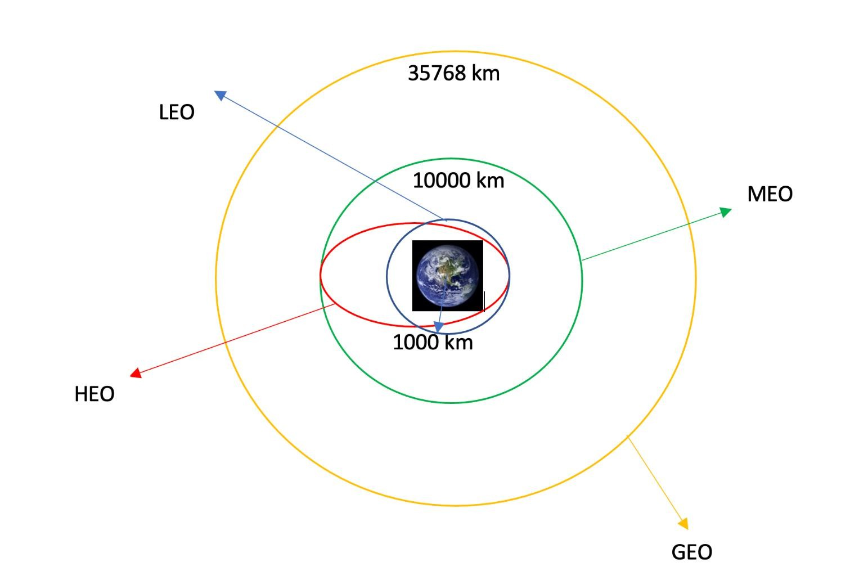
Data Wrangling
Specify the missing value
Calculate the number of launches on each site
Calculate the number and occurrence of each orbit
Calculate the number and occurrence of each orbit
Create a landing outcome label from Outcome column
Link: https://github.com/Jananijana2712/SpaceX-Falcon_9_First_Stage_Landing_Prediction/blob/main/1.3%20SpaceX%20Data%20Wrangling.ipynb

Slide 11

EDA with Data Visualization
The relationship between Flight Number and Launch Site -> scatter plot
The relationship between Payload and Launch Site -> scatter plot
The relationship between success rate of each orbit type -> bar plot
The relationship between Flight Number and Orbit type -> scatter plot
The relationship between Payload and Orbit type -> scatter plot
The launch success yearly trend -> line chart
The scatter plot is the best to describle the relation between two categorical data
The bar plot is the best to compare several categorical data
The line plot is the best to show the time series data
https://github.com/Jananijana2712/SpaceX-Falcon_9_First_Stage_Landing_Prediction/blob/main/1.4%20SpaceX%20%20the%20EDA%20with%20Visualization.ipynb

Slide 12
EDA with SQL
Display the names of the unique launch sites in the space mission
Display 5 records where launch sites begin with the string 'CCA’
Display the total payload mass carried by boosters launched by NASA (CRS)
Display average payload mass carried by booster version F9 v1.1
List the date when the first successful landing outcome in ground pad was achieved.
List the names of the boosters which have success in drone ship and have payload mass greater than 4000 but less than 6000
List the total number of successful and failure mission outcomes
List the names of the booster_versions which have carried the maximum payload mass.
List the records which will display the month names, failure landing_outcomes in drone ship ,booster versions, launch_site for the months in year 2015.
Rank the count of successful landing_outcomes between the date 04-06-2010 and 20-03-2017 in descending
order.
https://github.com/Jananijana2712/SpaceX-Falcon_9_First_Stage_Landing_Prediction/blob/main/Assignment%20SQL%20Notebook%20for%20Peer%20Assignment.ipynb

Slide 13


Build an Interactive Map with Folium
Mark all launch sites on a map
Mark the success/failed launches for each site on the map
Calculate the distances between a launch site to its proximities
  Whether it is close to the coast
  Whether it is close to the railway
  Whether it is close to the highway
  Whether it is close to the city
To find some geographical patterns about launch sites
https://github.com/Jananijana2712/SpaceX-Falcon_9_First_Stage_Landing_Prediction/blob/main/1.5%20SpaceX%20Interactive%20Visual%20Analytics%20with%20Folium.ipynb

Slide 14
Build a Dashboard with Plotly Dash
A launch site drop-down input component
A success-pie-chart based on the selected site dropdown
A range slicer to select payload
A success-payload-scatter-chart scatter plot based on the selected site dropdown
To inspect the relationship of success rate between lauch site and payload
https://github.com/Jananijana2712/SpaceX-Falcon_9_First_Stage_Landing_Prediction/blob/main/1.6%20SpaceX%20Machine%20Learning%20Prediction.ipynb

Slide 15


Predictive Analysis (Classification)
1
2
3
4
Data wrangling
Data standarization
Split into traning and test datasets
Predictive model evalutation
Logistic regression
Support vector machine
Decision tree classifer
K-nearest neighnors
Predictive model selection
K-nearest neighnors
https://github.com/xiaojie-qian/SpaceX-Falcon-9-first-stage-Landing-Prediction/blob/main/1.7%20SpaceX_Machine
%20learning%20predictive%20analysis.ipynb

Slide 16
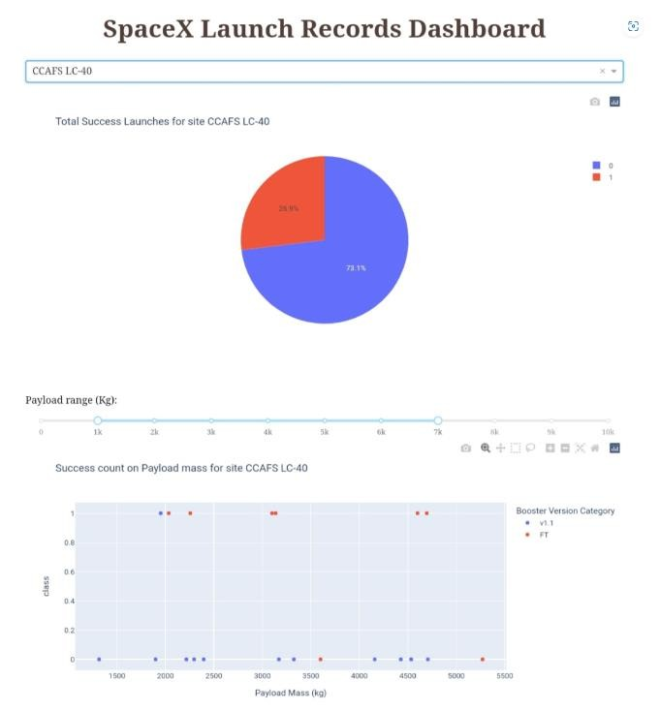
Results
EDA
KSC LC-39A and VAFB SLC
4E has a success rate of 77%
VAFB SLC 4E has no payload above 10000 kg
In the LEO orbit the Success appears related to the number of flights
With heavy payloads the successful landing or positive landing rate are more for Polar,LEO and ISS
The sucess rate since 2013 kept increasing till 2020
Interactive analytics
Predictive analysis
According to the decision tree classifier model, the predictive model tells us that there will be 4 ture postive, 7 true negative, 5 false postive and 2 false negative . The accuracy of the mode is around 89% with the best parameters.

Slide 17

Section 2

Slide 18
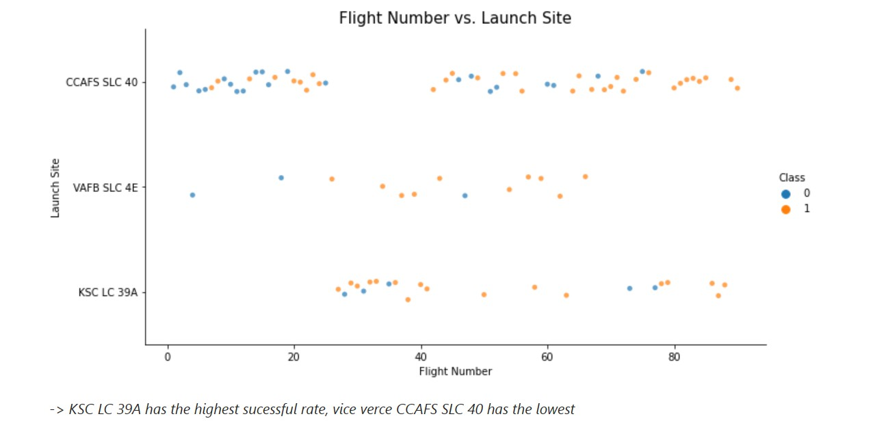
Flight Number vs. Launch Site
• According to the plot above, it's possible to verify that the best launch site nowadays is CCAF5 SLC 40, where most of recent launches were successful.
• In second place VAFB SLC 4E and third place KSC LC 39A.
• It's also possible to see that the general success rate improved over time.

Slide 19
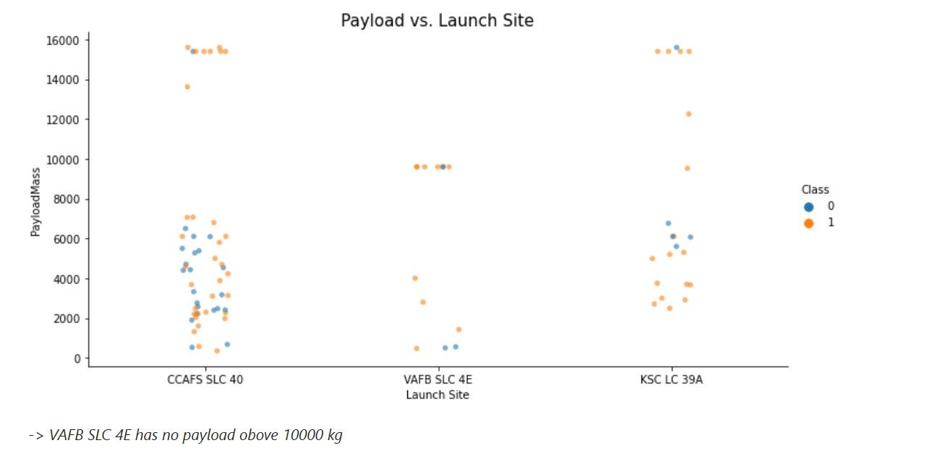
Payload vs. Launch Site
• Payloads over 9,000kg (about the weight Of a school bus) have excellent success
Rate.
• Payloads over 12,000kg seems to be possible only on CCAFS SLC 40 and KSC LC
39A launch sites.

Slide 20
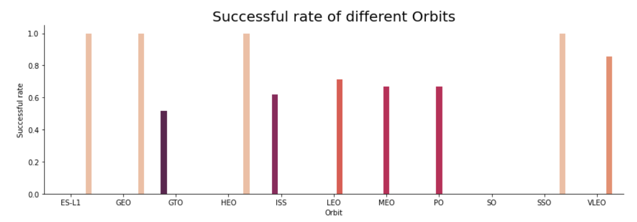
Success Rate vs. Orbit Type
The biggest success rates happens to orbits:
• ES-LI;
• GEO;
and
• sso.
Followed by:
• VLEO (above 80%) and
• LFO (above 70%).
-> ES – L1, GEO, HEO, SSO have the highest success rate

Slide 21
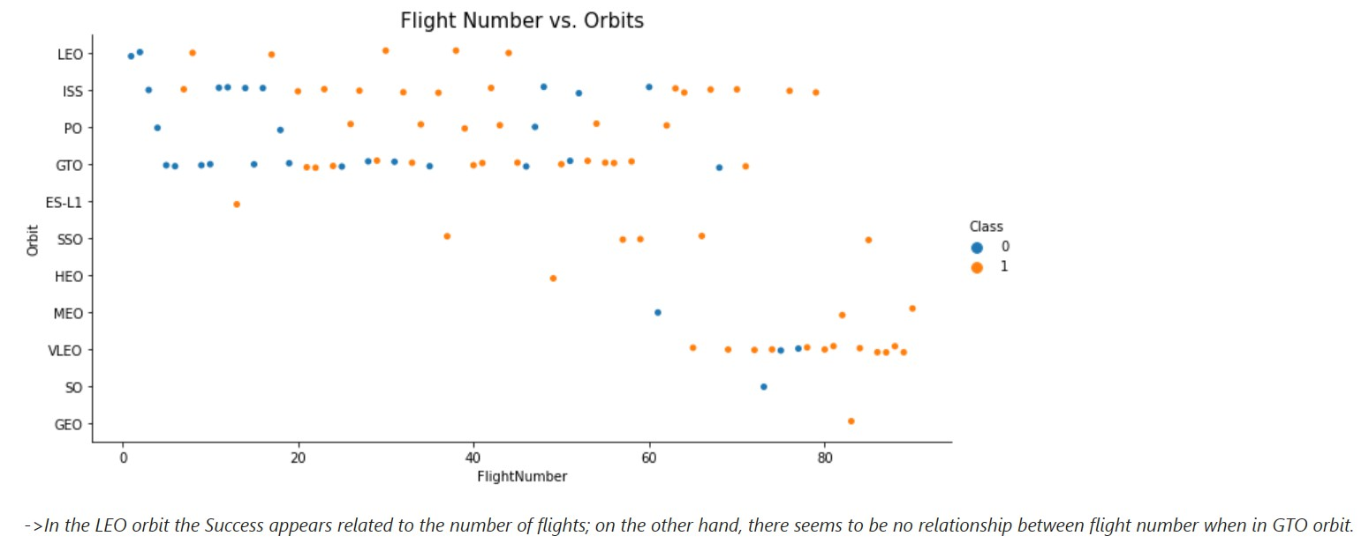
Flight Number vs. Orbit Type
• Apparently, success rate improved over time to all orbits;
• VLEO orbit seems a new business opportunity, due to recent increase of its
frequency.

Slide 22
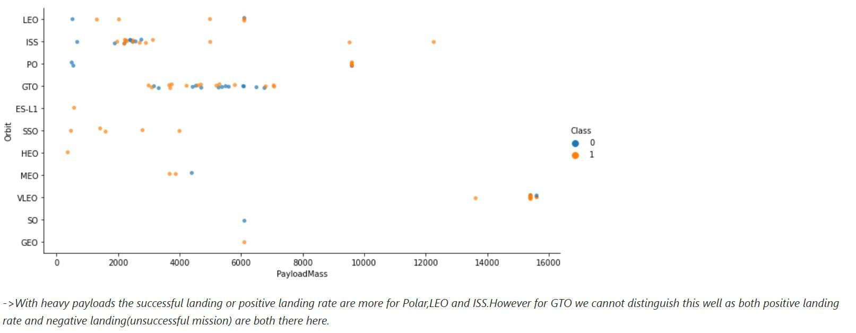
Payload vs. Orbit Type
• Apparently, there is no relation between payload and success rate to orbit GTO.
• ISS orbit has the widest range Of payload and a good rate Of success.
• There are few launches to the orbits SO and GEO.

Slide 23
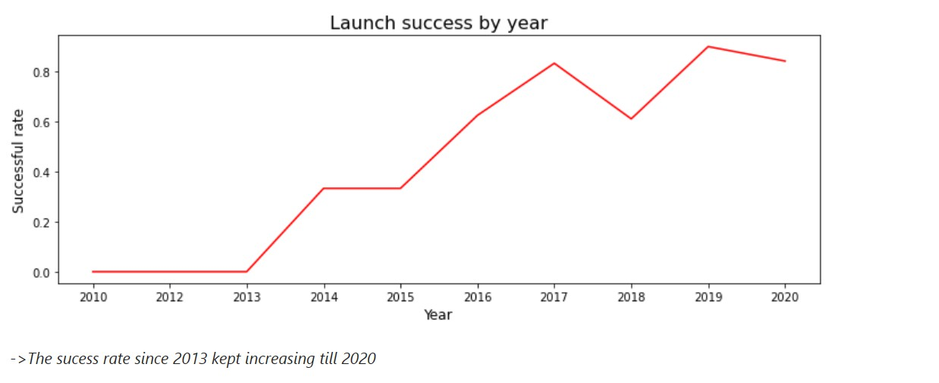
Launch Success Yearly Trend
• Success rate started increasing in 2013 and
kept until 2020.
• It seems that the first three years were a
period of adjusts and improvement of
technology.

Slide 24
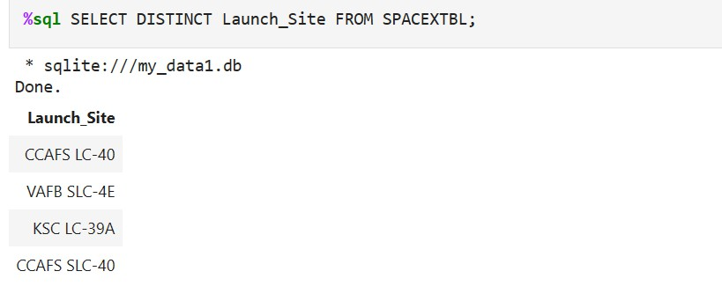
All Launch Site Names
According to data, there are four launch sites:
They are obtained by selecting unique occurrences of "launch_site" values
from the dataset.

Slide 25
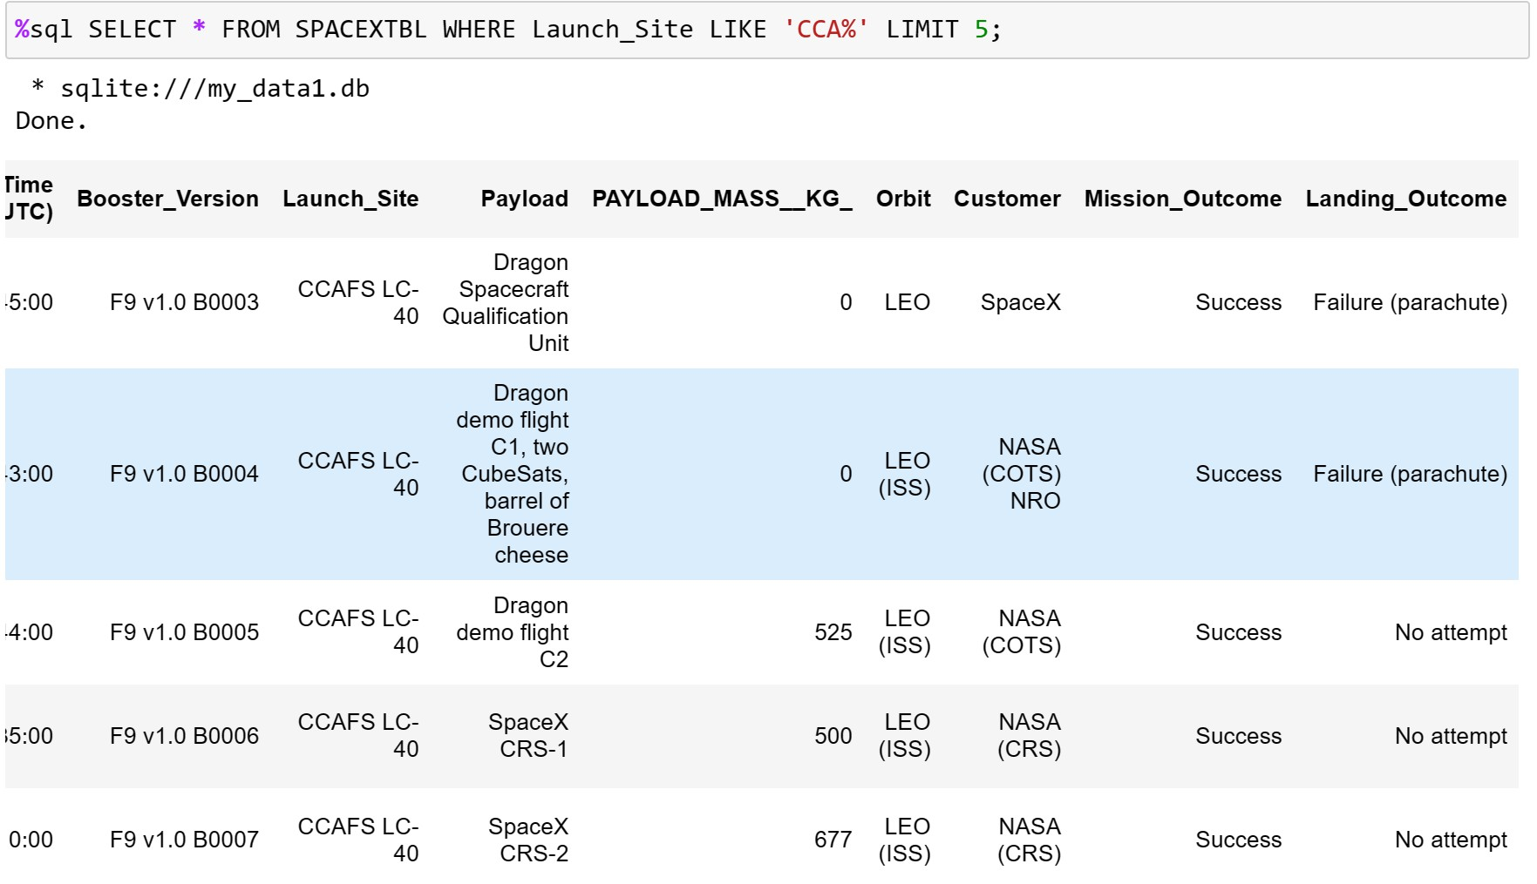
Launch Site Names Begin with 'CCA'
5 records where launch sites begin with 'CCA'
Here we can see five samples of Cape Canaveral launches.

Slide 26
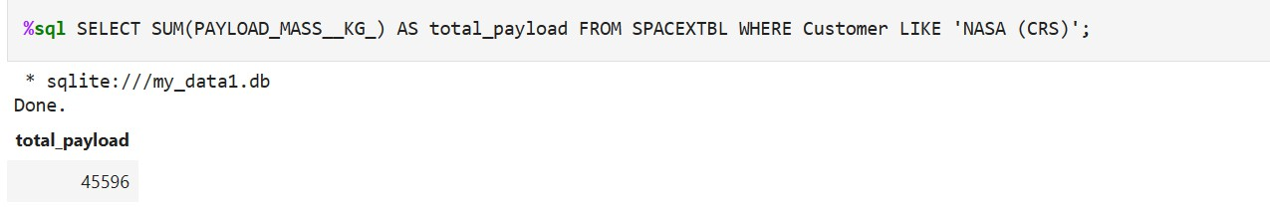
Total Payload Mass
Total payload carried by boosters from NASA:
Total payload calculated above, by summing all payloads whose codes
contain 'CRS', which corresponds to NASA.

Slide 27
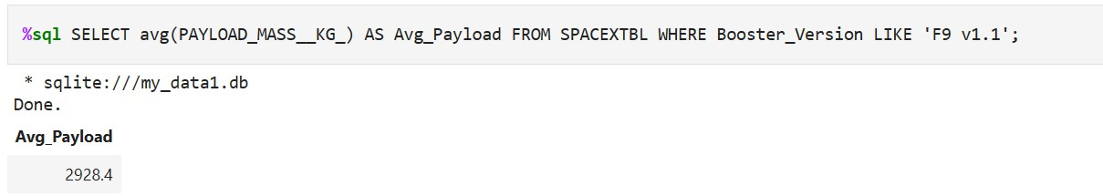
Average Payload Mass by F9 v1.1
Average payload mass carried by booster version F9 vl. 1 :
Filtering data by the booster version above and calculating the average
payload mass we obtained the value of 2,928 kg.

Slide 28
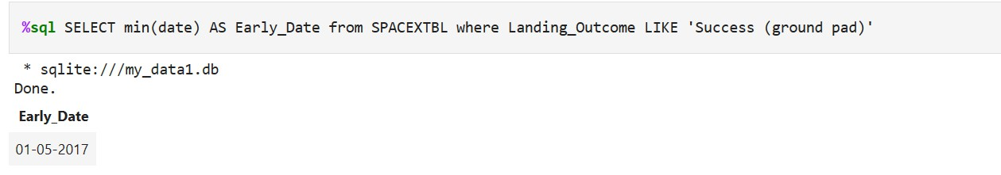
First Successful Ground Landing Date
First successful landing outcome on ground pad:
By filtering data by successful landing outcome on ground pad and getting
the minimum value for date it's possible to identify the first occurrence, that
happened on 12/22/2015.

Slide 29
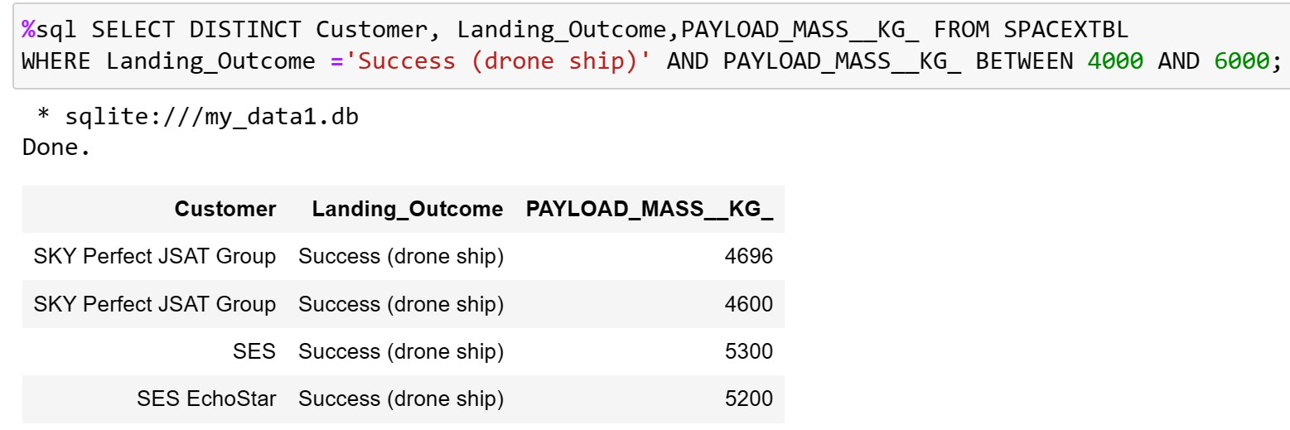
Successful Drone Ship Landing with Payload between 4000 and 6000
Boosters which have successfully landed on drone ship and had payload mass
greater than 4000 but less than 6000
Selecting distinct booster versions according to the filters above, these 4 are
the result.

Slide 30
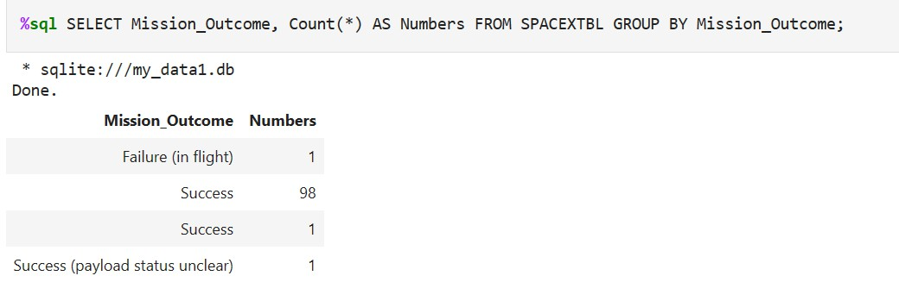
Total Number of Successful and Failure Mission Outcomes
Number of successful and failure mission outcomes:
Grouping mission outcomes and counting records for each group led us to
the summary above.

Slide 31
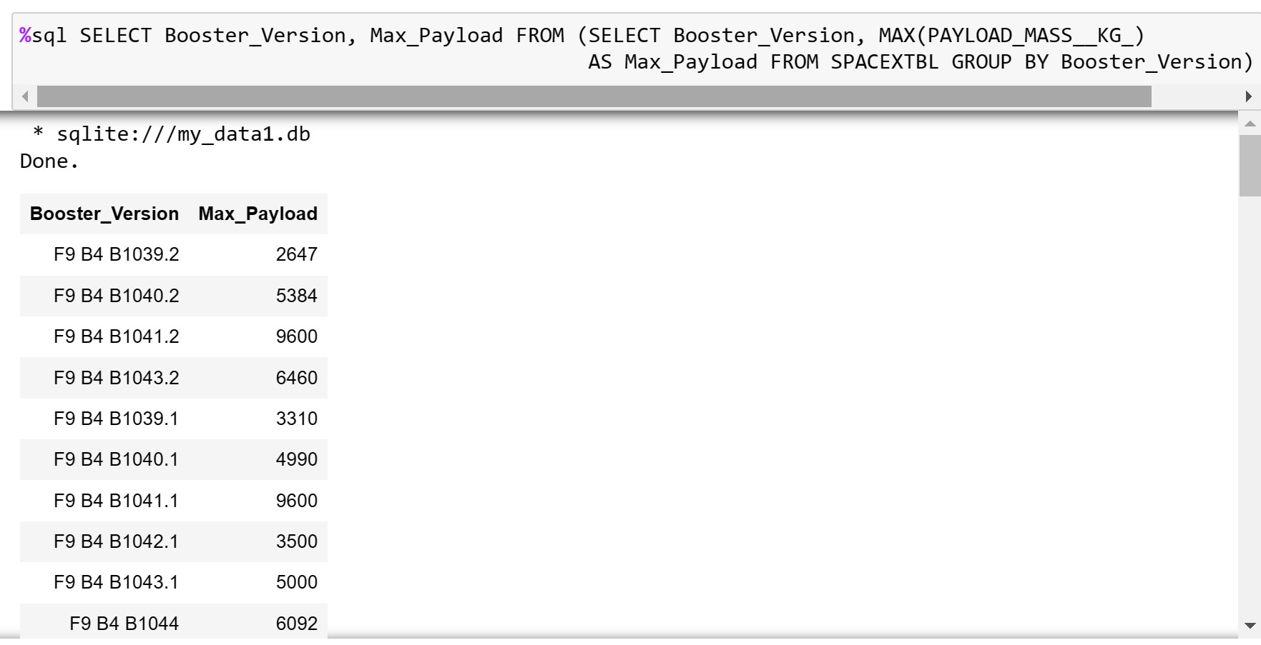
Boosters Carried Maximum Payload
Boosters which have carried the maximum payload mass
These are the boosters which have carried the maximum payload mass
registered in the dataset.

Slide 32
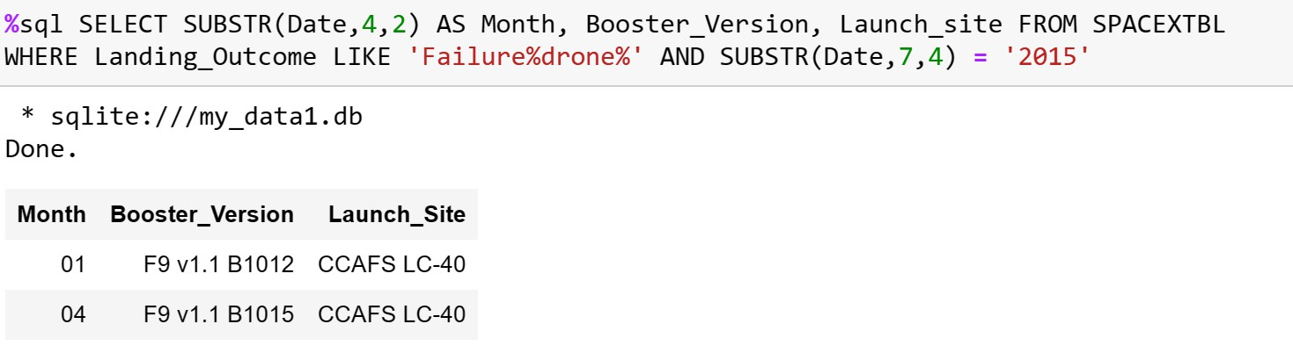
2015 Launch Records
Failed landing outcomes in drone ship, their booster versions, and launch site
names for in year 2015
The list above has the only two occurrences.

Slide 33
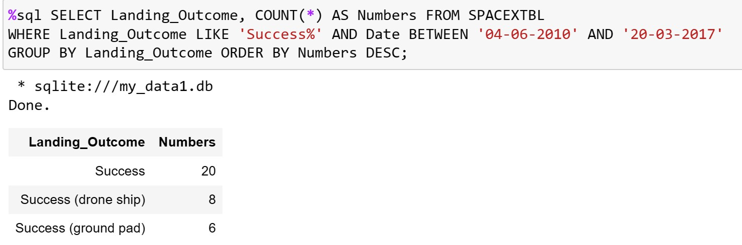
Rank Landing Outcomes Between 2010-06-04 and 2017-03-20
Ranking of all landing outcomes between the date 2010-06-04 and 2017- 03-20:
This view Of data alerts us that "NO attempt" must be taken in account.

Slide 34

Section 3

Slide 35
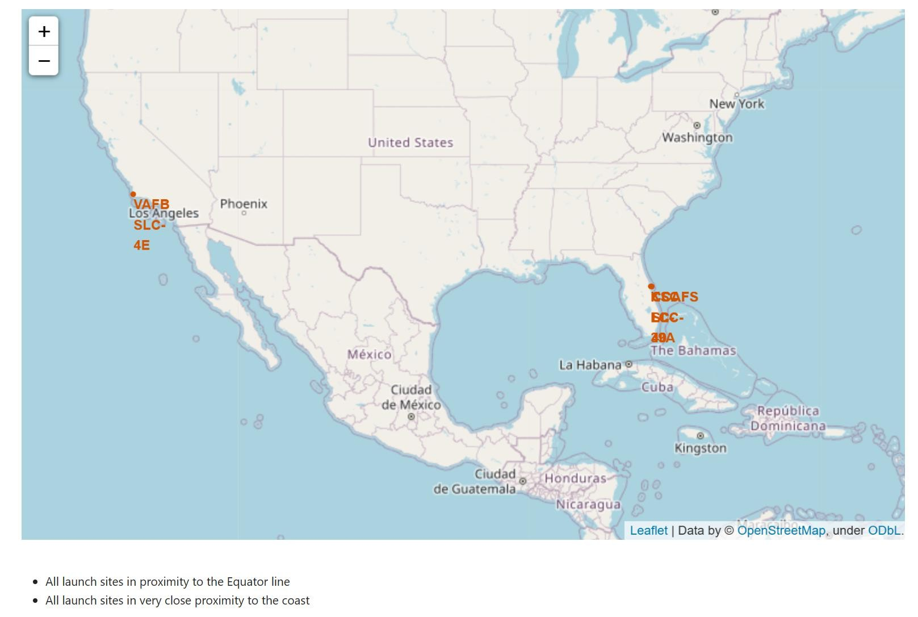
<All launch sites>
Launch sites are near sea, probably by safety, but not too far from roads and
railroads.

Slide 36
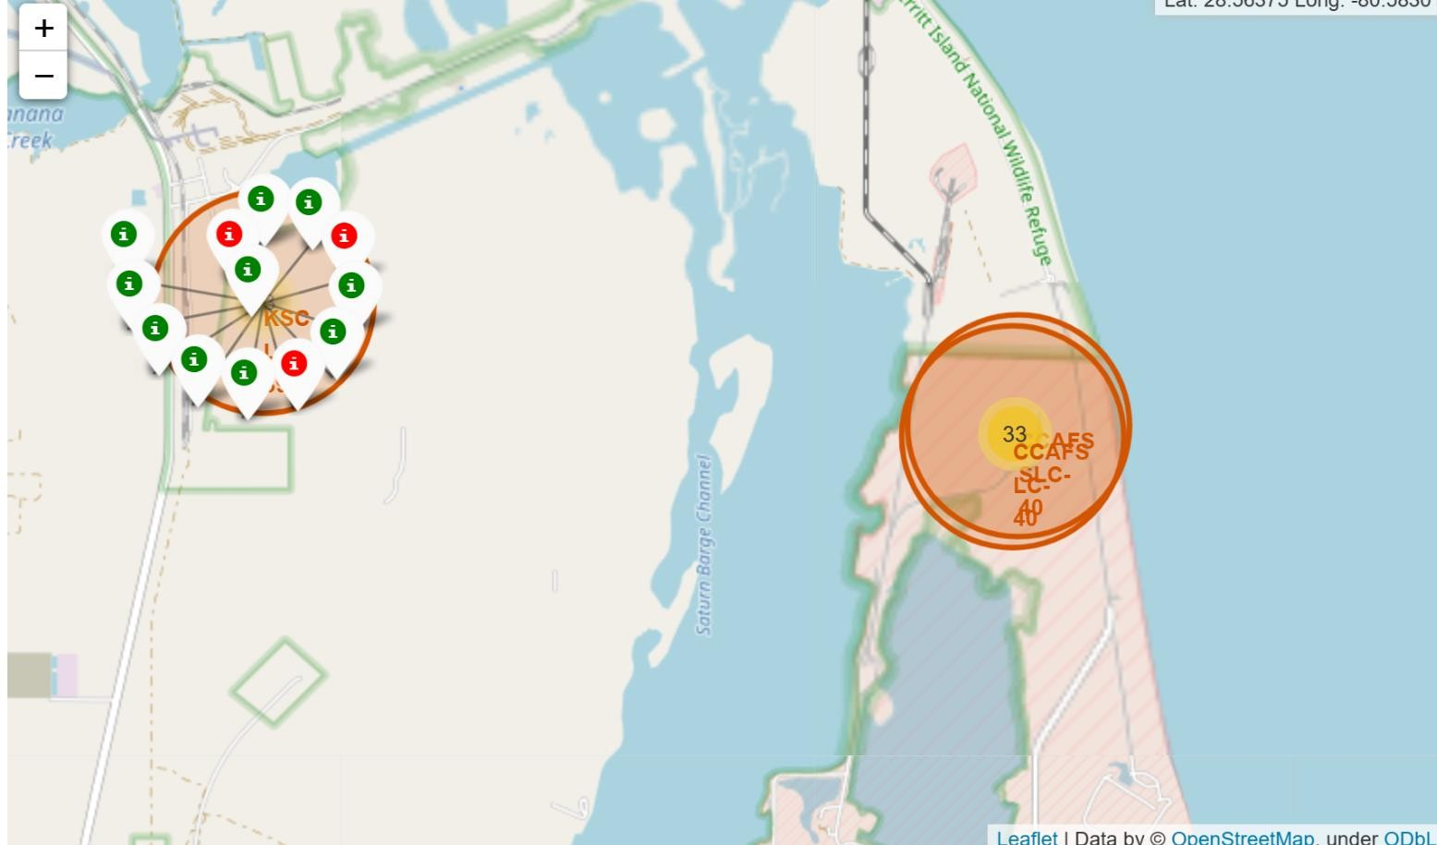
Launch outcome of different site
Example Of KSC LC-39A launch site launch outcomes
Green markers indicate successful and red ones indicate failure.

Slide 37
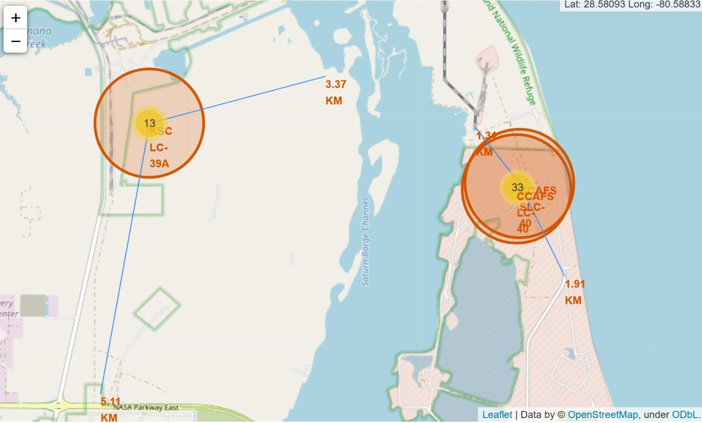
The proximity of the launch sites
Launch site KSC LC-39A has good logistics aspects, being near railroad and road and relatively far from inhabited areas.

Slide 38

Section 4

Slide 39
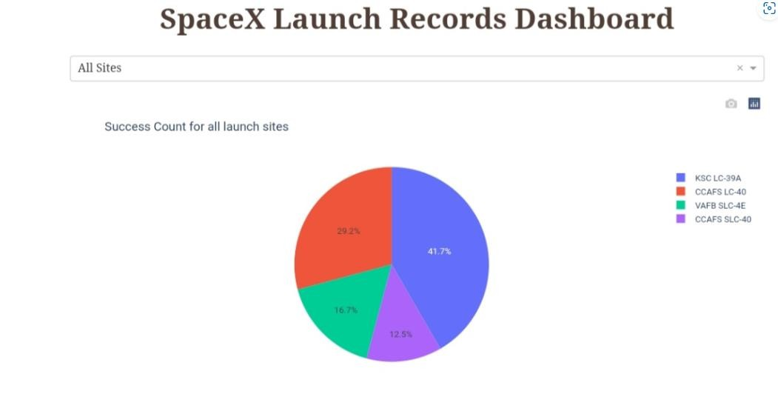
All site launch
KSC LC 39A: 41.7%
CCAFS LC-40: 29.2%
VAFB SLC -4E: 16.7%
CCAFS SLC-40: 12.5%
The place from where launches are done seems to be a very important factor of
success of missions.

Slide 40
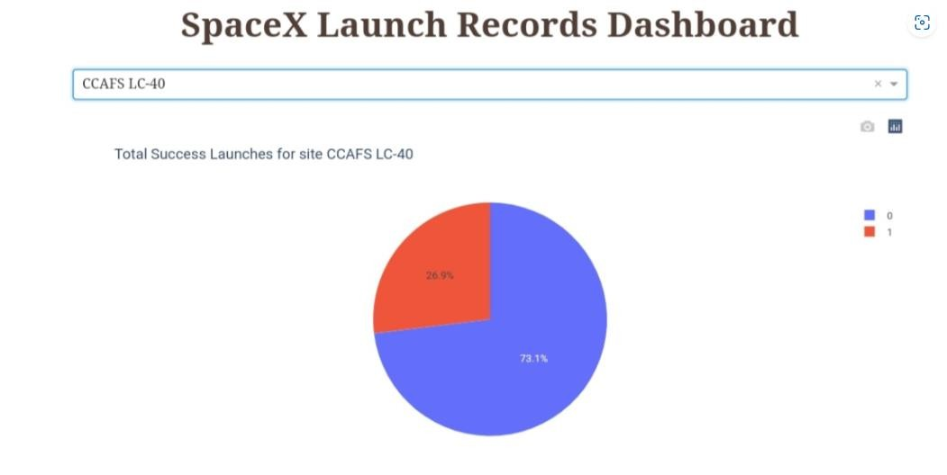
Highest success launch ratio
76.9% of launches are successful in this site.

Slide 41
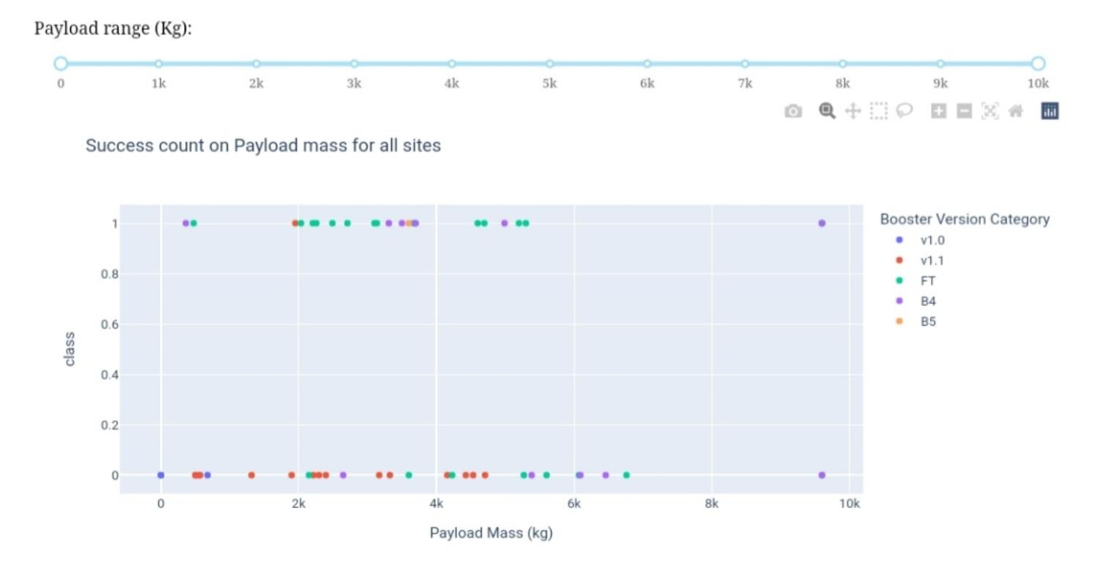
Payload vs. Launch Outcome
Payloads under 6,000kg and FT boosters are the most successful combination.

Slide 42

Section 5

Slide 43
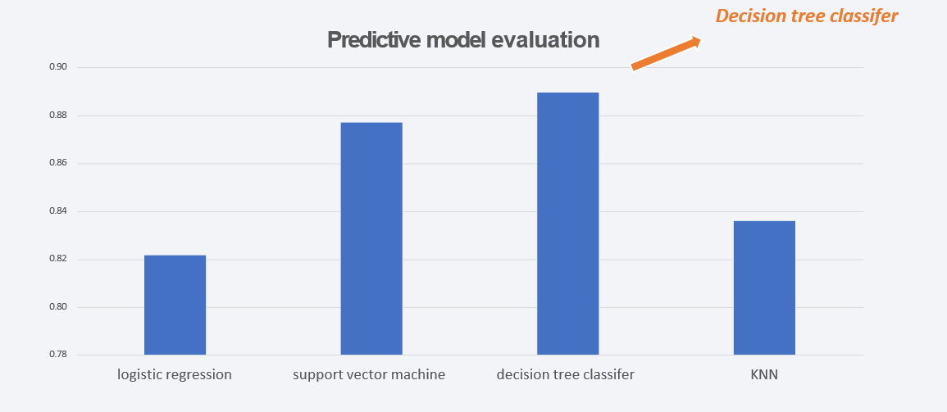
Classification Accuracy
• Four classification models were tested,
and their accuracies are plotted beside.
• The model with the highest classification
accuracy is Decision Tree Classifier,
which has accuracies over than 87%.

Slide 44
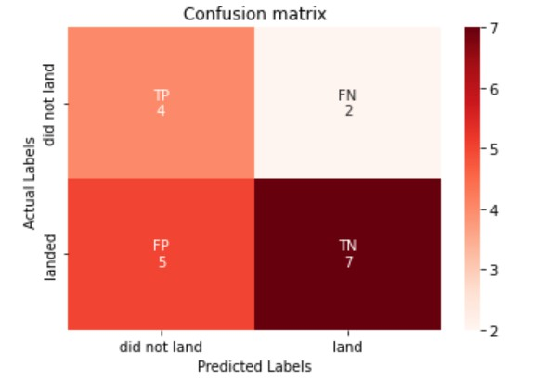
Confusion Matrix
True Positive = 4
Successful landing correctly predicted.
True Negative = 7
Failure correctly predicted.
False Positive = 5
Failure predicted as successful landing.
False Negative = 2
Successful landing predicted as failure.
Confusion matrix of Decision Tree Classifier proves its accuracy by showing the big
numbers Of true positive and true negative compared to the false ones.

Slide 45
Conclusions
Data Insights
Launch success varied across launch sites and orbit types.
Payload characteristics were associated with landing outcomes.
The yearly analysis showed an increasing success trend over the observed period.
Interactive Analytics
Folium provided geographical analysis of launch sites and nearby infrastructure.
Plotly Dash enabled interactive exploration of launch site, payload and landing outcomes.
Predictive Analysis
Four classification algorithms were evaluated.
The selected model and its performance were evaluated using classification metrics and a confusion matrix.
Overall
The project combined data collection, data wrangling, SQL, visualization, interactive analytics and machine learning to analyze Falcon 9 first-stage landing outcomes.

Slide 46
Creative Enhancements
🎨 Interactive Visual Analytics
Created an interactive Folium map to explore launch locations, landing outcomes, and proximity to geographical features such as coast, railway, highway and city.
📊 Interactive Dashboard
Developed a Plotly Dash dashboard with launch-site selection, payload filtering, success-rate visualization and payload/outcome analysis.
🔍 Multi-dimensional Analysis
Combined visual EDA, SQL analysis, geographical analysis and machine learning instead of relying on a single analytical approach.
🤖 Predictive Modeling
Compared multiple classification approaches — Logistic Regression, SVM, Decision Tree and KNN — and evaluated their performance.
Creative approach: The project combines static analysis with interactive geographical visualization, dashboard-based exploration and predictive modeling to provide multiple perspectives on Falcon 9 landing outcomes.

Slide 47
Innovative Insights
🚀 1. Launch success improved over time
The yearly analysis shows an increasing launch-success trend from 2013 through 2020.
📦 2. Payload and landing outcome are related
The analysis indicates that payload characteristics are associated with first-stage landing outcomes, with successful landings appearing more frequently in certain payload ranges.
🛰️ 3. Orbit type shows different success patterns
Landing success varies by orbit type, with ES-L1, GEO, HEO and SSO showing high observed success rates in the analysis.
📍 4. Geography provides additional context
Launch-site performance can be examined together with geographical proximity to coastlines, railways, highways and cities.
🤖 5. Machine learning can predict landing outcomes
Multiple classification algorithms were evaluated, with the Decision Tree reported at approximately 89% accuracy using the selected parameters.

Slide 48
Appendix
https://github.com/Jananijana2712/SpaceX-Falcon_9_First_Stage_Landing_Prediction
https://www.coursera.org/learn/applied-data-science-capstone/home/welcome

Slide 49


